Slide 1
Review: Adaptive Subgradient Methods for Online Learning and Stochastic Optimization¹
Xiao Shou
1. J. Duchi, E. Hazan, and Y. Singer. Journal of Machine Learning Research 12 (Jul): 2121--2159 (2011)

Slide 2
Overview:
Adagrad is gradient-based optimization approach
adapts the learning rate to the parameters, i.e. smaller updates with frequently occurring features, and larger updates with infrequent features
employ proximal functions to control the gradient steps of the algorithm adaptively

Slide 3
The optimization problem
opt prob:
ϕ_{t}(x) = f_{t}(x)+φ(x) where f_{t}(x) and φ(x) are (closed) convex functions.
f_{t}(x) instaneous loss function, φ(x) regularization
Regret R_{ϕ}(T)
Claim:
ψ_{t}(x) proximal term can lower the regret!

Slide 4
Bregman divergence
Intuitively, the difference between the value of ψ at x and the first order Taylor expansion of ψ around y evaluated at point x.

Slide 5
Projected Subgradient Revisit
regret = RL/sqrt(T)
Mirror Descent

Slide 6
Composite Mirror Descent
Composite : adding a regularization φ(x)
ŋ : stepsize
Proximal function: ψ_{t}(x) =1/2 * <x,G_{t}^{1/2}x>
Intutitively : x_{t+1} = argmin｛ f(x_{t}) + <x-x_{t},g_{t}> + 1/2*<x-x_{t}>'∇²f(x_{t})<x-x_{t}>｝
B_{ψt}(x,x_{t}) = 1/2 *||x-x_{t}||_{Gt}^{1/2}
G_{t} ^{1/2}:=∇²f(x_{t})
do not have access to ∇²f(x_{t}) , Let g1:t = [g1 ··· gt ] the matrix obtained by concatenating the subgradient sequence, outer product matrix

Slide 7
ADAGRAD family of algorithms
ψ_{t}(x) = <x,H_{t} x> for a symmetric matrix H_{t} ≥0
Informally, ψ_{t}(x) as reweighted L2 proximal term,
The update :

Slide 8
The regret improvement 1)
Recall: subgradient descent
mirror descent :dual norm
Composite Mirror with proximal: B_{ψt}(x,x_{t}) = ||x-x_{t}||_{Gt}

Slide 9
The regret improvement 2)
Full ADAGRAD
Diag ADAGRAD

Slide 10
The algorithms
Diag ADAGRAD
Full ADAGRAD

Slide 11
Evaluation
Pros
strong regret guarantees
adaptive methods outperform their non-adaptive counterparts
Cons
computationally infeasible to calculate to use ADAGRAD Full
ADAGRAD diag may not capture the interactions between features
(aka. low effective rank)
accumulation of the squared gradients cause rate to close to 0

Slide 12
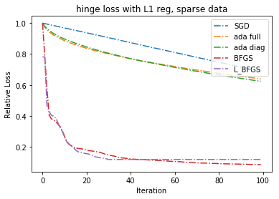
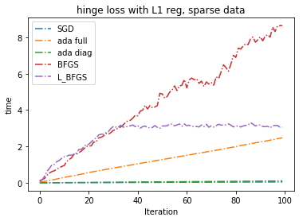
Methods Comparison on Sparcs Data
SPARCS data: subset newborn, binary variables
sparcs, 1000 x 400 variables, binary response
Stochastic Grad:
SGD, Adagrad (Full & Diagonal)
Non Stochastic Grad:
BFGS and L-BFGS
Conclusion:
Adagrad reaches lower regret bound SGD
BFGS methods reach close to optimal.
Adagrad, SGD fastest.

Slide 13
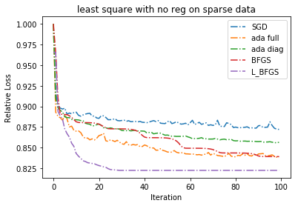
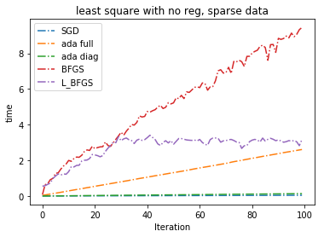
Methods Comparison on Sparcs Data: regression
Very similar pattern occurs except for BFGS, due to the very ill conditions hessian/gradient

Slide 14
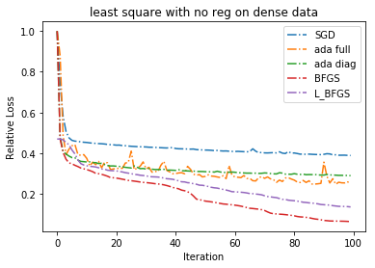
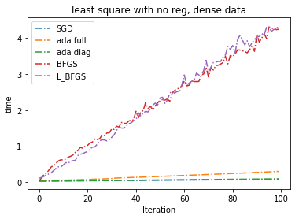
Methods Comparison on Dense Data: regression
Year prediction data : 10000 x 100

Slide 15
Conclusion
Overall ADAGRAD reaches a lower regret compared to SGD.
ADAGRAD diag is an execellent choice for large scale optimization due to the “adaptiveness” is almost “free”.
Turning for initial step size for ADAGRAD is an issue.
BFGS methods are good for relative small datasets.

